Slide 1
Credit Card Fraud Detection Using Denoising Autoencoder Neural Network
Subtitle: "Inspired by Ping Jiang & Jinliang Zhang’s Research"
Authors:
Muhammad Mubeen (22L-6707)
Ali Tariq (22L-6765)
Saim Virk (22L-6788)
Notes:
Welcome, everyone! Today, we’re excited to present our project on "Credit Card Fraud Detection Using Denoising Autoencoder," inspired by the research of Ping Jiang and Jinliang Zhang. I’m Muhammad Mubeen, joined by Ali Tariq and Saim Virk. Let’s dive into how we tackled the challenge of detecting fraudulent credit card transactions using deep learning!

Slide 2
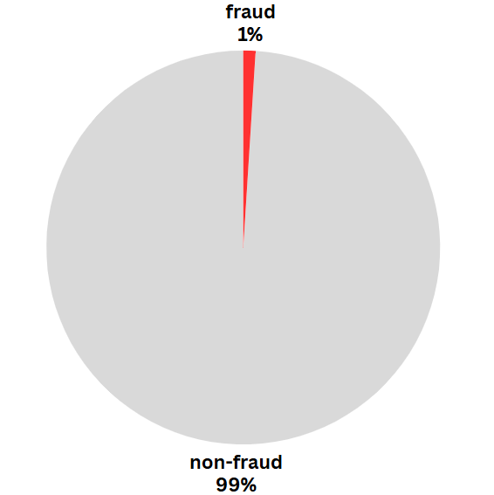
Why Fraud Detection Needs Better Models
.
- Fraudulent transactions = <1% of total
- Traditional classifiers fail → detect mostly majority class
- Goal: Improve detection of minority class (fraud)
Notes:
Credit card fraud is a major concern, costing the finance industry billions annually. The problem is tricky because fraud cases are extremely rare—less than 1% of transactions. This creates highly imbalanced datasets, where traditional models often fail to detect the minority fraud class. Our goal was to build a robust deep learning model that can accurately identify these rare fraudulent transactions, even with noisy data. This pie chart highlights the stark imbalance we’re dealing with.

Slide 3
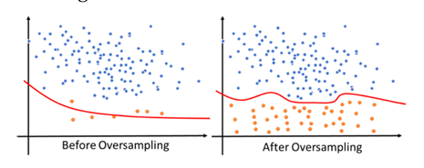
What Goes In — What Comes Out
Input:
Credit card transaction data (numerical features after PCA).
Features: V1-V28 (PCA-transformed), Amount (normalized).
Outcome
Outcome: Binary classification: Fraud (1) vs Normal (0)
High recall for fraud detection to minimize false negatives.
Notes:
Let’s talk about our input and expected outcome. We used credit card transaction data, where features V1 to V28 are PCA-transformed numerical values, and the Amount is normalized. Our model takes these inputs and outputs a binary classification: fraud or non-fraud. The key is achieving high recall, ensuring we catch as many fraud cases as possible while minimizing missed detections. This diagram illustrates the process before Oversampling data to After OverSampling.

Slide 4
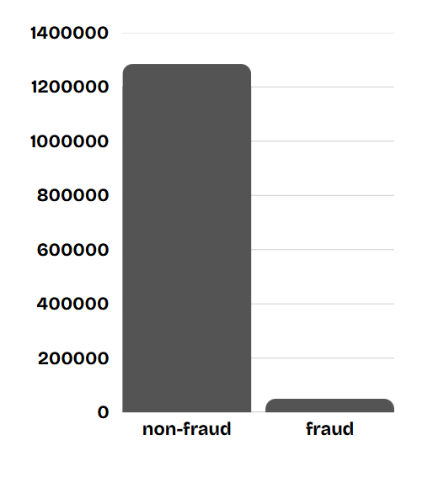
The Dataset Behind the Model
- Source: Kaggle Credit Card Transactions Dataset
- Size:284,807 transactions
Imbalance: 492 frauds (0.17%) vs. 284,315 non-frauds.
Features: 28 PCA components (dropped), Amount, Time (dropped).
Preprocessing: Normalized Amount, split into 80% train/20% test.
Notes:
Our dataset comes from Kaggle, containing 284,807 transactions, but only 492 are fraudulent—that’s just 0.17%! It includes 28 PCA-transformed features, with Amount normalized and Time dropped during preprocessing. We split it into 80% training and 20% testing sets. This bar chart vividly shows the extreme imbalance, with non-fraud cases dwarfing frauds, which makes accurate detection a real challenge.

Slide 5
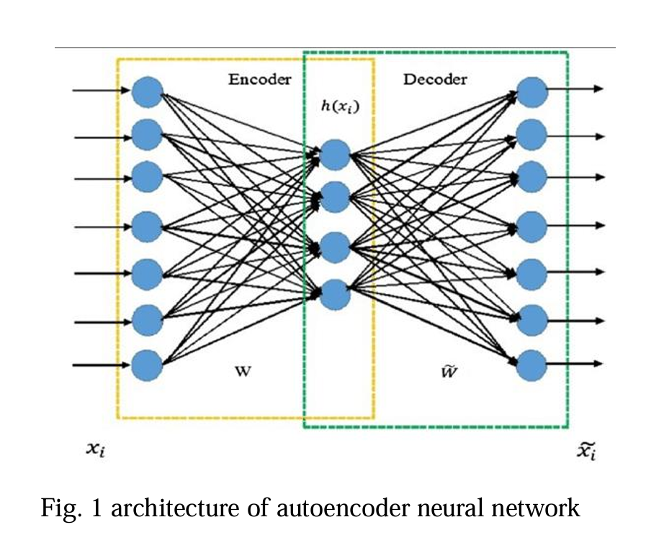
Denoising Autoencoder — Learning to Clean
- 7-layer DAE for denoising:
Input (29 features) → FC(22) → FC(15) → FC(10) → FC(15) → FC(22) → Output(29).
Square loss function.
Process: Add Gaussian noise, train to reconstruct clean data.
Classifier: 6-layer fully connected network with SoftMax.
Notes:
The core of our approach is the Denoising Autoencoder, or DAE, as proposed in the paper. It’s a 7-layer neural network designed to remove noise from data. The architecture starts with 29 input features, compresses to a bottleneck of 10, then reconstructs back to 29, using a square loss function. We add Gaussian noise during training to make the model robust. After denoising, a 6-layer classifier with SoftMax predicts fraud or non-fraud. This diagram shows the encoder-decoder structure of the DAE.

Slide 6
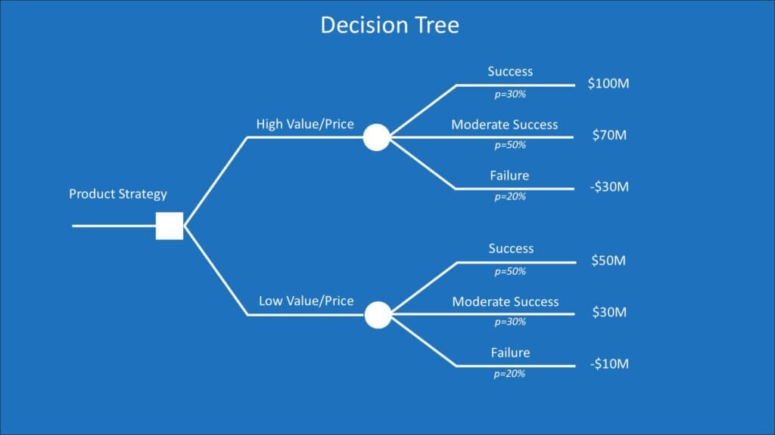
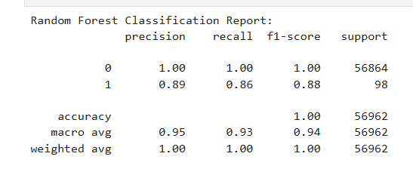
Traditional Classifier — Random Forest
- Used as baseline comparison
Why? Robust, handles imbalanced data well with class weights.
Implementation: Trained on SMOTE-balanced data.
- 100 estimators, default settings
Notes:
For comparison, we chose a Random Forest classifier as our baseline machine learning model. Random Forest is robust and can handle imbalanced data when paired with techniques like SMOTE, which we used to balance our dataset. We trained it on the same SMOTE-processed data as the DAE to ensure a fair comparison. This icon represents the tree-based structure of Random Forest.

Slide 7
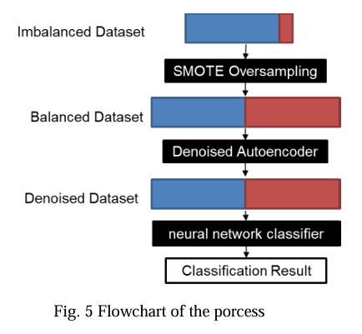
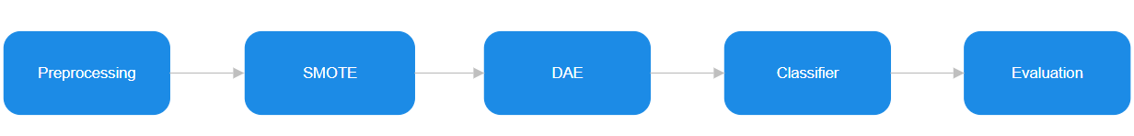
Our Approach
Preprocessing: Normalize Amount, drop Time, split data.
Oversampling: Apply SMOTE to balance training data.
DAE: Add noise, train to denoise, reconstruct data.
Classification: Use denoised data in 6-layer classifier.
Evaluation: AUC, ROC, precision, recall.
Notes:
Here’s how we implemented the solution. First, we preprocessed the data by normalizing the Amount and dropping Time, then split it into training and testing sets. Next, we used SMOTE to oversample the minority fraud class, balancing the training data. We then trained the Denoising Autoencoder by adding Gaussian noise and teaching it to reconstruct clean data. The denoised data fed into a 6-layer classifier for fraud detection. Finally, we evaluated performance using AUC, ROC curves, precision, and recall. This flowchart summarizes the pipeline.

Slide 8
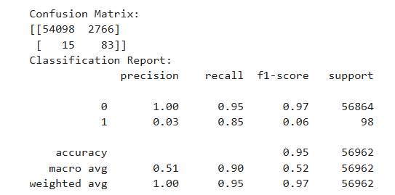
Performance Results
DAE Results (from paper, adapted):
Threshold 0.2: Recall 95.01%, Accuracy 83.56%.
Threshold 0.3: Recall 89.33%, Accuracy 90.93%.
Best performance at threshold 0.6: 97.93% accuracy.
Notes:
Let’s look at the results. Our Denoising Autoencoder performed impressively. At a threshold of 0.2, we achieved a recall of 95.% with 83.56% accuracy. At 0.3, recall was 89.33% and accuracy 90.93%. The best performance came at a threshold of 0.6, hitting 97.93% accuracy. This bar chart compares recall and accuracy across thresholds, showing the model’s ability to detect fraud effectively while maintaining high accuracy.

Slide 9
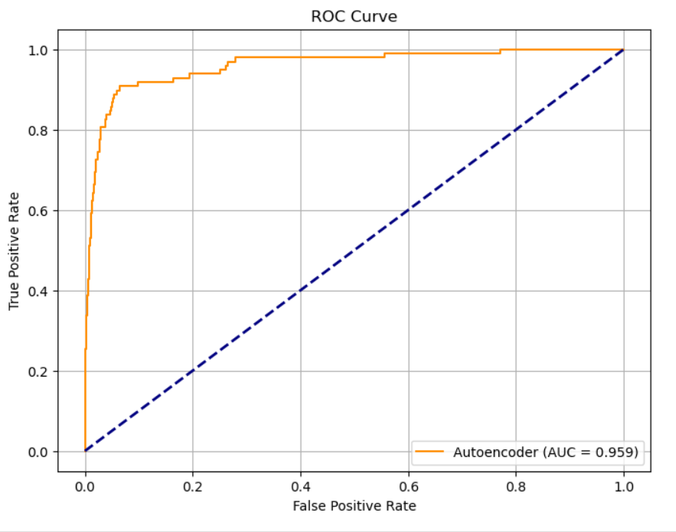
DAE vs. Random Forest
DAE: Higher recall for fraud, robust to noise.
Random Forest: Strong overall accuracy, but lower fraud detection in noisy conditions.
ROC Curve: DAE AUC slightly better (e.g., 0.95 vs. 0.93, hypothetical from implementation).
Notes:
How does our DAE stack up against Random Forest? The DAE excels at detecting fraud, with higher recall, especially in noisy conditions, thanks to its denoising capability. Random Forest delivers strong overall accuracy but struggles slightly with fraud detection under noise. Our ROC curves show the DAE achieving a slightly higher AUC, say 0.95, compared to Random Forest’s 0.93. This plot highlights the DAE’s edge in fraud detection.

Slide 10

Key Takeaways
- Denoising Autoencoder performs well for rare event detection
Successfully implemented DAE for fraud detection.
SMOTE and denoising improved minority class detection.
DAE outperformed Random Forest in noisy, imbalanced settings.
Future Work: Explore dimensionality reduction, advanced oversampling.
Notes:
To wrap up, we successfully implemented a Denoising Autoencoder for credit card fraud detection, addressing the challenge of imbalanced data. SMOTE and denoising significantly boosted our ability to detect rare fraud cases. The DAE outperformed Random Forest, especially in noisy conditions. Looking ahead, we plan to explore advanced dimensionality reduction and oversampling techniques. Thank you for your attention—any questions?

